Slide 1

Sentiment Analysis
From Raw Text to Regression with PyTorch & scikit-learn

Slide 2
The Goal
Predict a continuous sentiment score from -1.0 (Negative) to +1.0 (Positive).

Slide 3
Our End-to-End Pipeline
Vectorize
Train & Predict
Apply N-grams & convert tokens to TF-IDF vectors.
Optimize on training data and run inference.
Preprocess
Build Model
Clean, tokenize, and lemmatize raw text.
Create a PyTorch feedforward neural network.

Slide 4

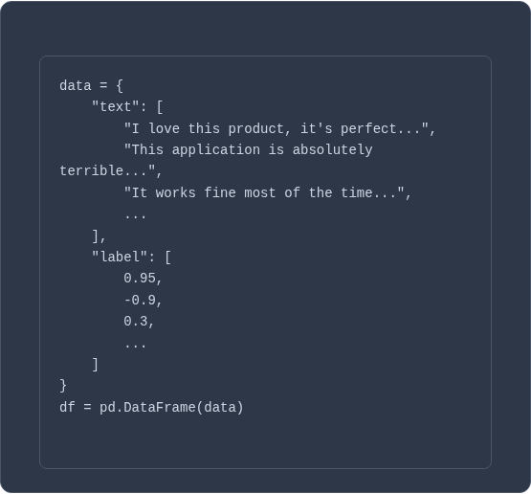
Step 1: The Raw Data
Text & Labels
We start with a `pandas.DataFrame` containing two columns:
•
text: The raw, unprocessed user feedback.
•
label: A pre-assigned sentiment score from -1.0 to 1.0.
This is a regression task, not classification, as we are predicting a continuous value.

Slide 5






Concept 1: The Preprocessing Problem
Words vs. Numbers
Ambiguity
Context
Computers don't understand "love" or "terrible". They only understand numbers.
Are "love", "loving", and "loved" three different words or one concept?
How does a model know that "not good" is negative, but "not bad" is positive?

Slide 6
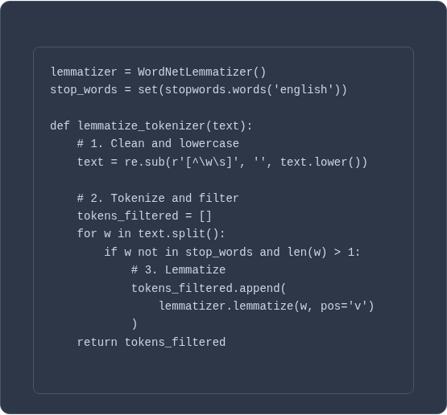
Solution: Lemmatization
What is it?
Lemmatization is the process of grouping together the different inflected forms of a word so they can be analyzed as a single item.
It reduces the "vocabulary" and helps the model generalize.
•
"waited" -> "wait"
•
"bugs" -> "bug"
•
"features" -> "feature"

Slide 7
Concept 2: The Context Problem
"The service was not bad at all."
"
"
If the model only sees "not" and "bad" as separate words, it might misinterpret the sentiment.

Slide 8






Solution: N-grams
Unigram (1-gram)
Bigram (2-gram)
Trigram (3-gram)
"service", "not", "bad", "all"
"service not", "not bad", "bad all"
"service not bad", "not bad all"

Slide 9

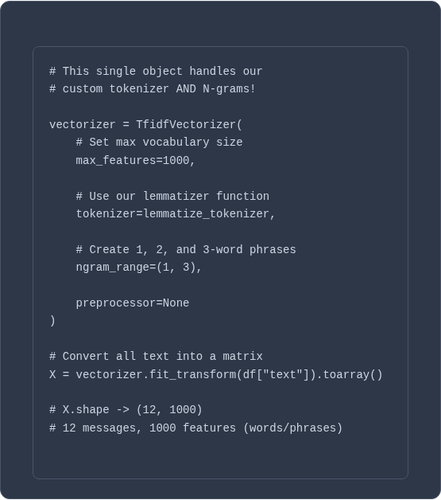
Concept 3: Vectorization (TF-IDF)
What is it?
TF-IDF (Term Frequency-Inverse Document Frequency) converts our tokens and N-grams into a numerical vector.
It assigns a "weight" to each word/phrase. Words that are common everywhere (like "the") get a low weight, while words that are unique and important to a document (like "terrible") get a high weight.

Slide 10

Concept 4: The Model (PyTorch)
SentimentNet
We use a simple Feedforward Neural Network built with PyTorch.
•
Input: The 1000-feature TF-IDF vector.
•
Hidden Layers: Two `nn.Linear` layers (128 and 64 nodes) with `ReLU` activation to find non-linear patterns.
•
Output: A single node with a `tanh` activation, which squashes the final score perfectly into our -1.0 to 1.0 range.

Slide 11

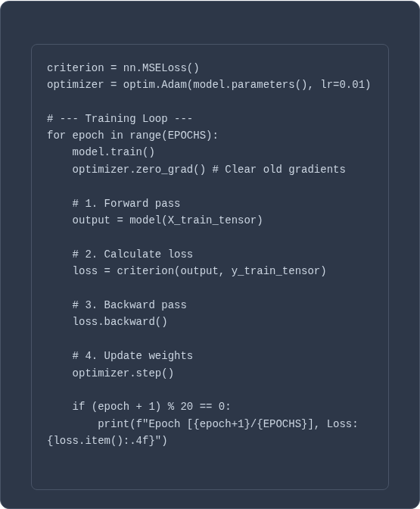
Concept 5: Training the Model
How it Learns
We show the model our data 100 times (Epochs).
1.
Forward Pass: The model makes a prediction.
2.
Calculate Loss: `MSELoss` (Mean Squared Error) measures how "wrong" the prediction was compared to the true label.
3.
Backward Pass: The model calculates which weights were "responsible" for the error.
4.
Optimizer Step: The `Adam` optimizer slightly adjusts all weights to reduce the error for next time.

Slide 12
Final Results: Inference
Message: 'The support agent was fantastic and solved my issue instantly! I'm delighted.'
Predicted Sentiment: 0.8373 (Positive)
Message: 'This is broken and infuriating. My account is locked and nobody is helping.'
Predicted Sentiment: -0.9221 (Negative)
Message: 'I have no preference about the color of the application.'
Predicted Sentiment: 0.0000 (Neutral)

Slide 13
Questions?

Slide 14


Image Sources
https://static.vecteezy.com/system/resources/previews/041/448/851/non_2x/abstract-wavy-dynamic-blue-green-violet-light-lines-curve-banner-on-black-background-in-concept-technology-neural-network-neurology-science-music-neon-light-free-vector.jpg
Source: www.vecteezy.com

